Slide 1
NFL Predictions
Creating a Machine Learning Model to Predict NFL Matchups
Notes:
Niki, Lisa, Josh & Myself

Slide 2
Executive Summary
It has been three years since the Supreme Court legalized sports betting. Currently, only half of the states in the US allow sports betting, but still, the amount of money being bet on sports has quadrupled since becoming federally legal.
Where there is opportunity for financial gain, there is often innovation. Due to the statistical nature of sports, machine learning methodologies seemed like a perfect fit for making sports game predictions.
In this project we develop and compare multiple machine learning models and use them to make predictions on NFL matches.
Notes:
It has been three years since the Supreme Court legalized sports betting. Currently, only half of the states in the US allow sports betting, but still, the amount of money being bet on sports has quadrupled since becoming federally legal.
Where there is opportunity for financial gain, there is often innovation. Due to the statistical nature of sports, machine learning methodologies seemed like a perfect fit for making sports game predictions.
In this project we develop and compare multiple machine learning models and use them to make predictions on NFL matches.
Goal was to develop a working model that predicts over 60% of the games correctly.

Slide 3
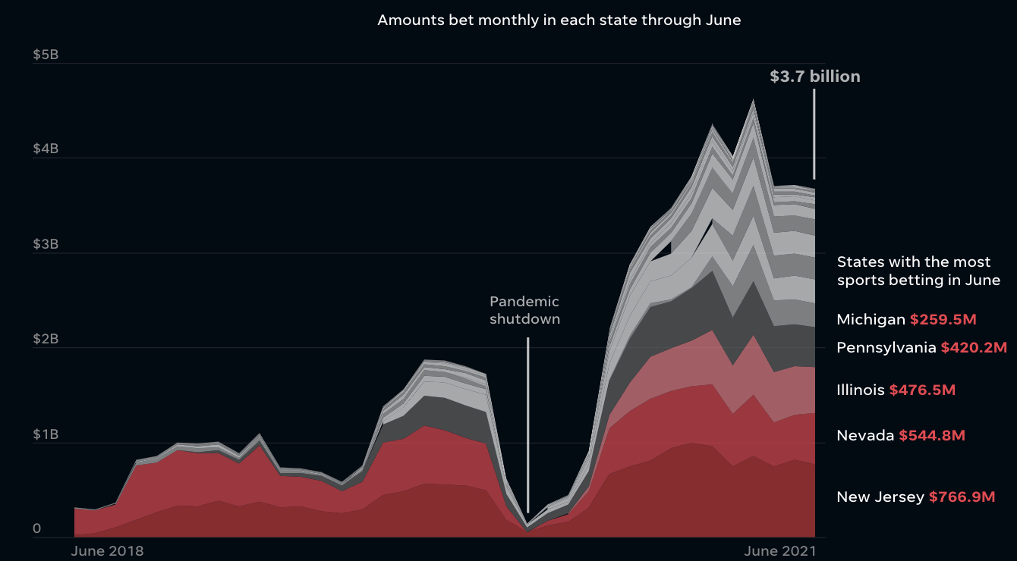
Source: USAToday
Notes:
Through 2021 so far, the amount of money bet on sports each month is nearly $4 billion dollars.
https://www.usatoday.com/in-depth/graphics/2021/09/09/online-sports-gambling-good-bet-industry-continue-winning-ways/5686836001/

Slide 4
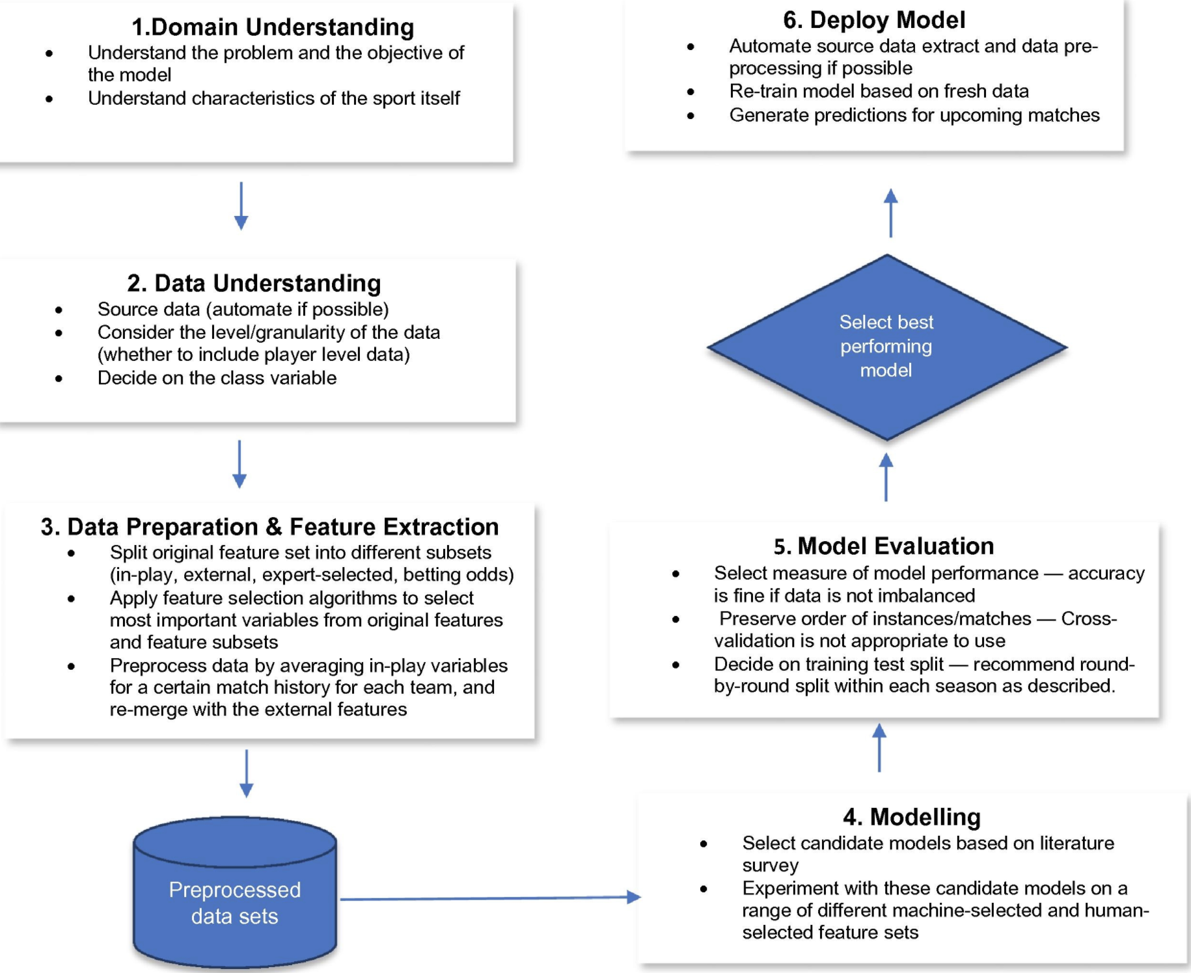
Approach & Framework
CRISP-DM Model
Cross Industry Standard Process for Data Mining
Notes:
https://www.sciencedirect.com/science/article/pii/S2210832717301485
https://www.datascience-pm.com/crisp-dm-2/
Understand the Sport
Find where to source the data and decide what to predict.
Decide the features
Select the Models
Evaluate the Models
Deploy the model and try to predict upcoming matches.

Slide 5
Data Collection & Preparation
Sportsipy API
Sports-Reference.com
Guide on How to Predict NFL Winners with Python
FiveThirtyEight - ELO Rating
Machine Learning Framework for Sports Result Prediction
NFL Team Stats 2002-2020 (Kaggle)
Used Sportsipy API to pull stats from Sports-reference.com
Followed Guide by Dante Sblendorio on how to pull match up data from sports-reference.com
Considered Kaggle NFL Match-Up Datasets
Notes:
Used Sportsipy API to pull stats from Sports-reference.com
Followed Guide by Dante Sblendorio on how to pull match up data from sports-reference.com
Used FiveThirtyEights ELO ratings - pulled from Github
Considered Kaggle NFL Match-Up Datasets

Slide 6
Feature Selection - Quantitative & Qualitative
First Downs
Fourth Down Conversions
Interceptions
Pass Completions
Penalties
Rush Touchdowns
Third Down Conversions
Times Sacked
Yards from Penalties
Fourth Down Attempts
Fumbles
Net Pass Yards
Pass Touchdowns
Points Scored
Rush Yards
Time of Possession
Total Yards
Yards Lost From Sacks
Fumbles Lost
Pass Attempts
Pass Yards
Rush Attempts
Third Down Attempts
Turnovers
ELO Pre-game QB Rating
ELO Pre-game Team Rating

Slide 7
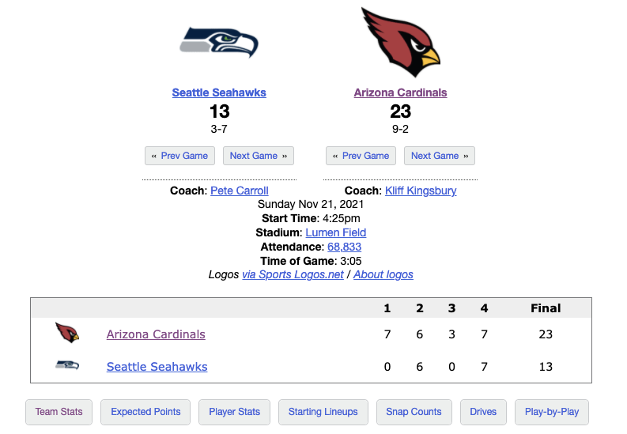
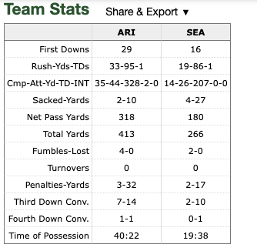
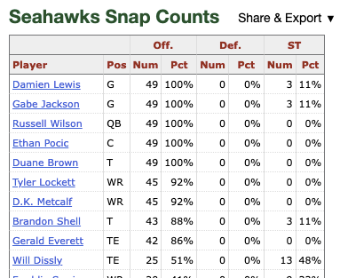
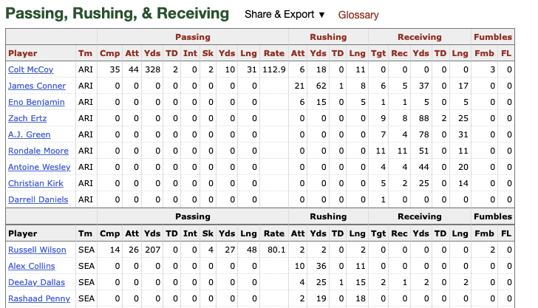
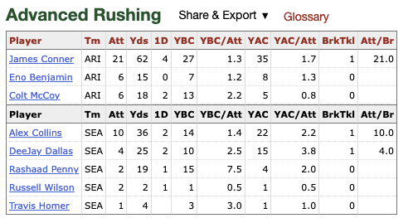
Pro-football-reference.com - Examples of Boxscore Stats Page

Slide 8
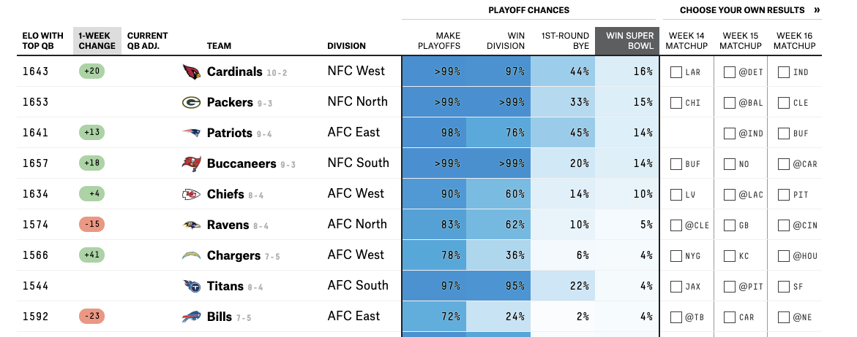
FiveThirtyEight - ELO Example

Slide 9

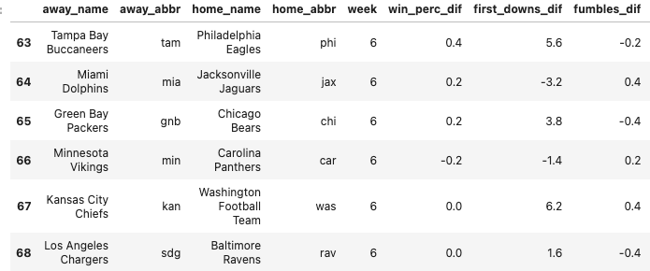
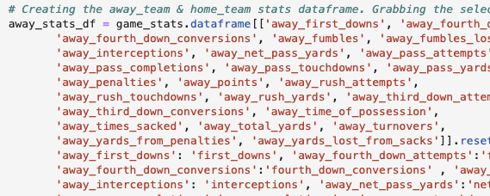
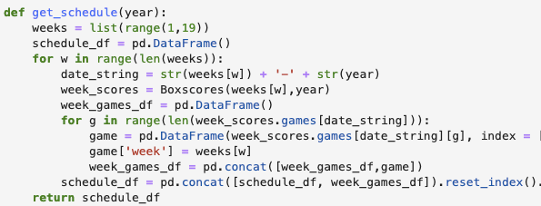
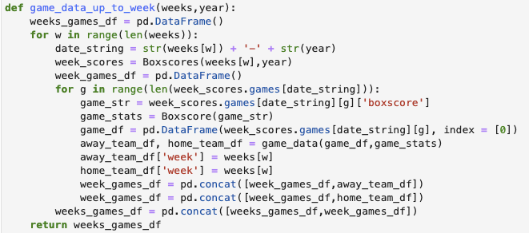
Sportsipy In Action
Notes:
Used a function to pull the entire season schedule.
Populated the games in that schedule with home & away team stats.
Created a function to aggregate each teams stats as of a given week.
Then we created differential columns for each match up and dropped the regular stat columns.
At that point we had our entire dataset to split and train and test on.

Slide 10
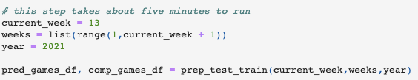
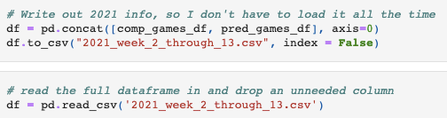
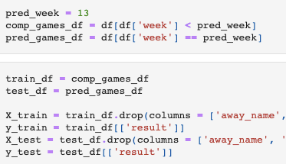
Preparing Data for Processing
Use API to pull data up to the current week in the NFL schedule.
When predicting a given week or backtesting:
Enter the prediction week
Create dataframe for completed games (up to the week before prediction week). This is the train dataframe.
Create dataframe for prediction week. This is the test dataframe.
“Result” is removed from the test DF.
Result = 1 if away_team wins
Result = 0 if away_team loses

Slide 11
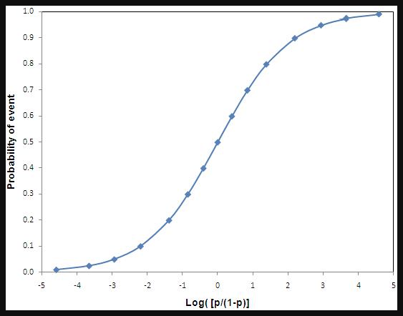
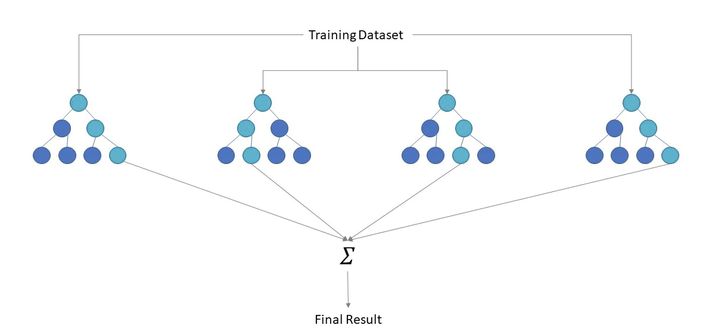
Model Selections
It was important that our models could predict probabilities so that we could understand the confidence level of the prediction.
Neural Networks were touted as working well in the sports prediction sphere.
Logistic Regression - S Curve Fits Sports Results
Logistic Regression
Deep Neural Network
RandomForest
Notes:
It was important that our model could predict probabilities or confidence intervals so we could tell whether a game was a close match or a predicted blow out.
So far we’ve used a Logistic Regression Model, Deep Neural Network and Random Forest.

Slide 12
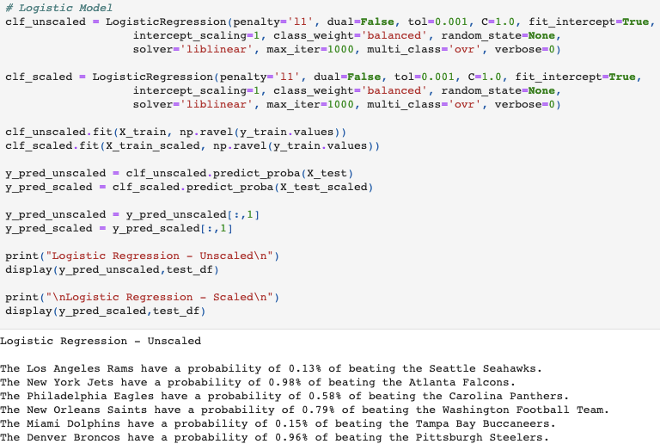
Logistic Regression Model - Scaled & Unscaled
Season Average Thus Far (Weeks 2 - 13):
Scaled: 62.3%
Unscaled: 63%
Notes:
Penalty - Sparse data/regularization
Fit intercept = Y intercept is fit based on data
Class_weight = use the value of y to adjust weights
Liblinear - good for small datasets

Slide 13
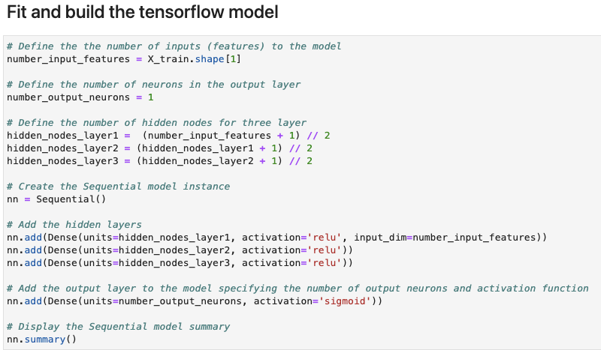
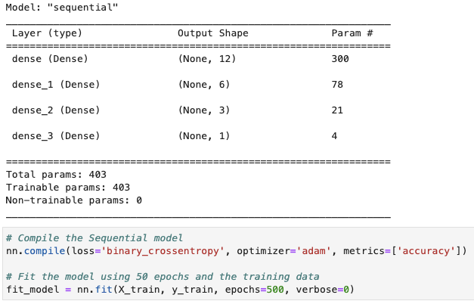
Deep Neural Network
Season Average Thus Far (Weeks 2 - 13):
50.9%

Slide 14
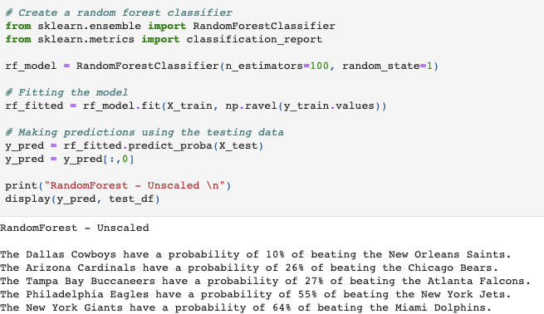
Random Forest Model
Season Average Thus Far (Weeks 2 - 13):
66.2%

Slide 15
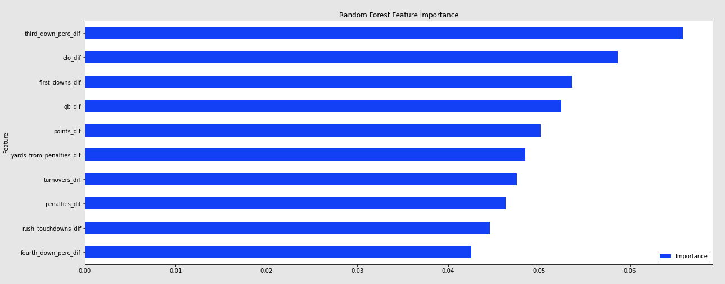
Random Forest Model - Feature Importance
Notes:
We really like the feature importance chart of the random forest model.

Slide 16
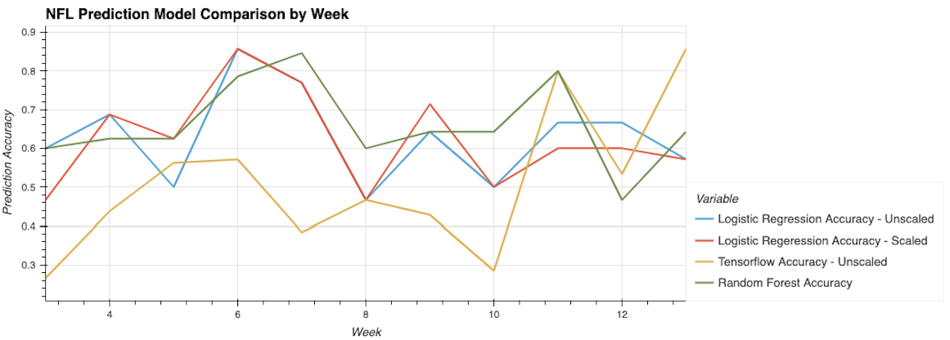
Model Comparison - Weekly

Slide 17
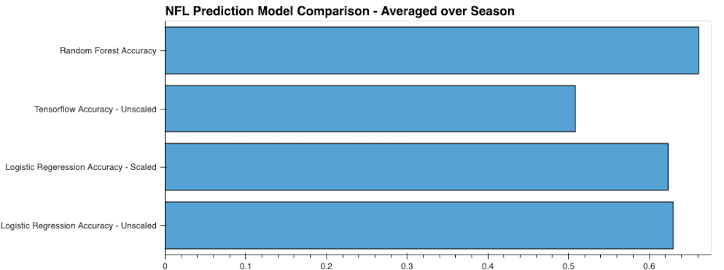
Model Comparison - Season Averages

Slide 18
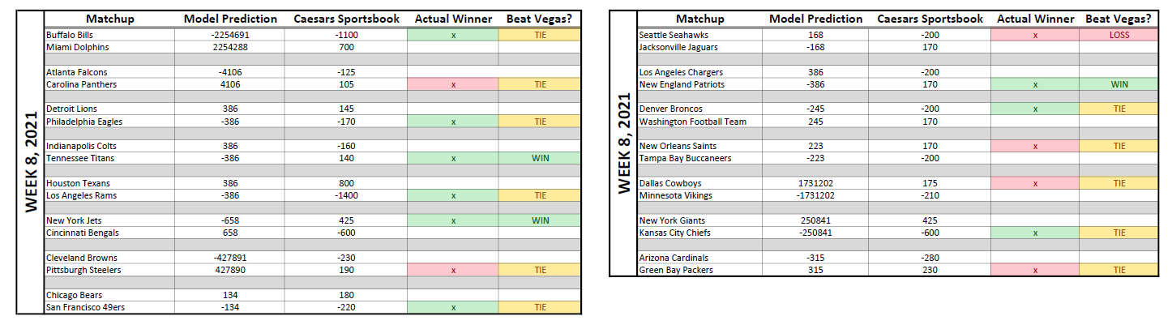
Model Predictions vs. Caesars Sportsbook
(Week 8, 2021)
Correct Predictions: 9/15 (60% Accuracy)
Predicted Same Winners as Caesars Sportsbook: 11/15
Out-predicted Caesars Sportsbook: 2
Out-predicted by Caesars Sportsbook: 1
Notes:
Another way for us to analyze our model is to compare it with actual sports book lines.
Looking at this example week, we predicted the same winners as Ceasars 11 of 15 games. We actually out predicted them by 1 game.

Slide 19
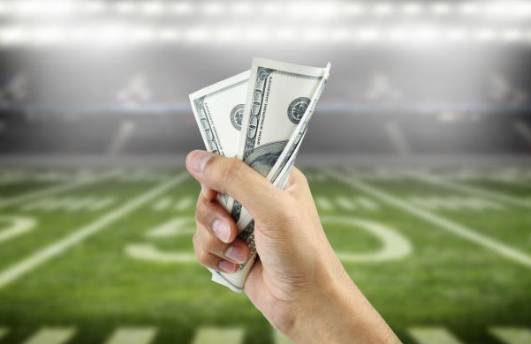
Conclusion
Were we successful? Kind of…
In order to win money on a bet with -110 odds you need a winning percentage of 52.4%.
Our best model returned a winning percentage of 66.2%.
What about when picking favorites?
Odds are worse
To breakeven your required winning percentage goes up
Example: Denver Broncos vs. Detroit Lions (W14)
Broncos -375
Assuming you bet a sample of 100 bets on -375 favorites you would need a prediction percentage of 79% to breakeven.
Notes:
https://www.bestuscasinos.org/blog/percentage-to-break-even-betting-on-sports/

Slide 20
Project Pros & Cons
Difficulties
Code Review & Update
Tie Week
Training Set Including Test Set
Sports-Reference API
For Loops
Model Parameters
Time Management
Successes
Interest in Data/Topic
Real-Time Data
Detailed Guide for using API
Lots of Information Available on Sports Prediction

Slide 21
Next Steps
For our Model
Rolling Window Features - Is a team trending up or down?
Adjusting Features - Drop & Add Features
More Defensive Features
Weighting Features
Different NN Depths
Post-Season Predictions
In Application
Calculated Odds Based on Model Predictions vs. Professional Sports Book Odds
Usage Framework - Narrow in on Best Bets
Analysis of Upset Games
Apply to Other Sports
Basketball
Soccer
Baseball

Slide 22
But Most Importantly…

Slide 23
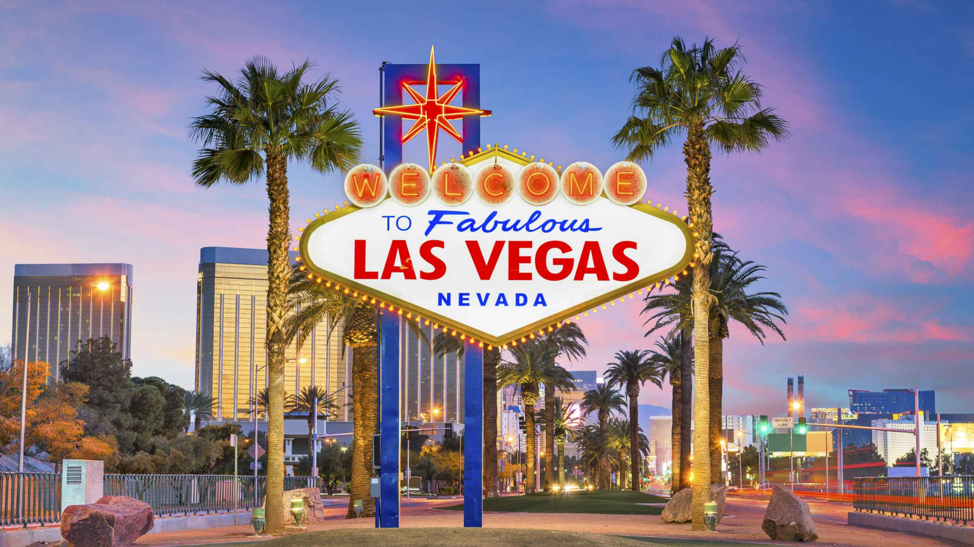
A Team Trip to Las Vegas…

Slide 24
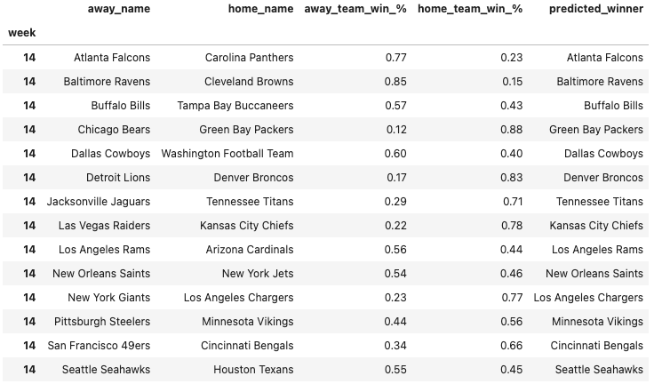
Week 14 - RandomForest Predictions

